Slide 1

Branded. Verified. Delivered.
Your team writes the substance. DocMark turns it into decks, reports and spreadsheets in your exact brand — and checks every file before it reaches you.
© 2026 DocMark. All rights reserved.
docmark.md
Notes:
If your firm sends reports, decks and spreadsheets to clients, every one has to look right. DocMark is built for that. Your team writes the substance. DocMark turns it into documents in your exact brand, and checks every file before it reaches you.

Slide 2
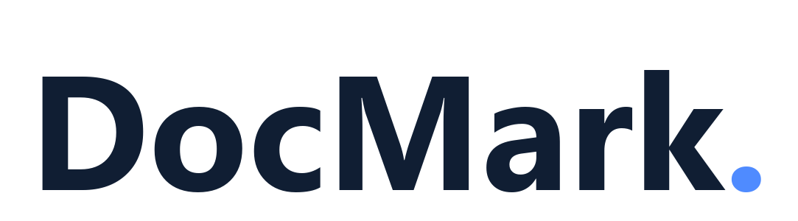
The Problem: Hours on Formatting, Not Substance
1
Hours per document go on assembly, branding and layout — not substance.
2
Documents bounce back for visual and brand fixes, and each bounce costs senior-review time.
3
Partner review starts at the formatting instead of the thinking.
© 2026 DocMark. All rights reserved.
docmark.md
Notes:
Start with the problem. Hours per document go on assembly, branding and layout, not substance. Documents bounce back for visual and brand fixes, and each bounce costs senior-review time. And partner review starts at the formatting instead of the thinking.

Slide 3
What DocMark Does
1
Send your content
2
Render in your brand
Through the web app, the API, your AI assistant, or, in a self-managed deployment, a watched folder.
Tested code applies your brand specification: fonts, colours, logos, layouts. AI never draws your deliverable.
3
Verify
4
Deliver
Every file is checked by an automated verification gate before delivery; a file that fails is withheld, with findings.
Verified decks, documents, spreadsheets, newsletters, brochures and video, each recording which version of your brand made it.
© 2026 DocMark. All rights reserved.
docmark.md
Notes:
DocMark works in four steps. First, you send your content, through the web app, the API, your own AI assistant, or, in a self-managed deployment, a watched folder. Second, tested code applies your brand specification, the same way every time. AI never draws the deliverable. Third, every file goes through an automated verification check before delivery. A file that fails is held back, with the reasons. Fourth, you get the verified file, with a record of which version of your brand made it.

Slide 4
Who DocMark Is Built For
Commercial real estate & valuation
High-volume, deadline-driven client reporting where every deck carries the firm's brand, now extended to branded video summaries (narrated, live today).
Consulting & advisory
Analysts author the substance; DocMark does assembly, branding and verification.
Financial services
Pitch books, valuation reports and fund updates where the brand is the credibility and the content is client-confidential.
Contractors serving the public sector
Reports with strict templates and data-handling expectations.
Agencies & brand studios
Each client brand is a committed specification with its own design profiles, so switching brands is a configuration change, not a template hunt.
© 2026 DocMark. All rights reserved.
docmark.md
Notes:
DocMark is built for firms where the brand standard is enforced and the documents go to clients. Commercial real estate and valuation firms, with high-volume, deadline-driven reporting, now including branded video summaries. Consultancies, where analysts write the substance and DocMark handles assembly, branding and verification. Financial services, where the brand is the credibility and the content is confidential. Contractors whose public-sector clients set strict templates. And agencies, where each client's brand is its own specification, so switching brands is a configuration change, not a template hunt.

Slide 5
What Reformatting Costs You: Your Numbers
The figures below are illustrative placeholders, not claims.
Your input | Example placeholder
Client-facing documents per month (volume) | 200
Formatting share: hours per document on assembly, branding and layout | 1.5 h
Rework rate: share of documents bounced back for brand fixes | 15%
Senior-review time per bounce | yours
Loaded cost per analyst hour, and per senior-reviewer hour | yours
Estimated monthly value
≈ (volume × formatting share × analyst rate) + (volume × rework rate × review time × reviewer rate).
Compare that against the deployment-mode pricing and the one-off brand onboarding fee.
© 2026 DocMark. All rights reserved.
docmark.md
Notes:
Rather than quote you a number, here's how to work out your own. You need your monthly document volume, the hours each spends on formatting rather than substance, how often one bounces back for brand fixes, how much senior-review time each bounce costs, and what an hour costs for your analysts and your reviewers. The formula on the slide turns those into a monthly figure. Compare that against the deployment-mode pricing and the one-off brand onboarding fee. The example numbers are placeholders, not claims. The pilot's success criteria are agreed up front, so "did it work?" is a number, not a feeling.

Slide 6
What "Verified" Means
What's checked (as of September 2026)
Blank or failed pages and contrast for decks; structural and integrity checks for documents, spreadsheets and brochures; duration and container integrity for video.
Every file is checked by an automated verification gate before delivery; a file that fails is withheld, with findings.
Planned, not yet available
Deeper visual proof-reading (logo, colour, overflow).
Verified doesn't mean fact-checked
Your authors own the substance.
© 2026 DocMark. All rights reserved.
docmark.md
Notes:
Here's what "verified" means. Every file is checked automatically before it's delivered, and a file that fails is held back, with the reasons. As of September 2026, the checks catch blank or failed pages and contrast problems in decks, structural and integrity problems in documents, spreadsheets and brochures, and duration and container problems in video. Deeper visual proof-reading, of logos, colour and overflow, is planned but not yet available. And verified doesn't mean fact-checked. Your authors own the substance.

Slide 7
Three Ways to Run It
On-prem
Client cloud
DocMark cloud
Nothing leaves your building: no internet, no AI, no telemetry.
Your content stays in your own cloud, except for AI calls to the provider you bring (Anthropic today), under your own account and contract. Optional web research sends search queries out.
DocMark processes your content, but the servers that build your file never receive your sign-in identity. Anything inside your files is processed as content. Encrypted in transit; Anthropic is a named sub-processor.
Compare the modes → docmark.md/enterprise/compare
© 2026 DocMark. All rights reserved.
docmark.md
Notes:
DocMark runs three ways. On-prem, nothing leaves your building: no internet, no AI, no telemetry. In your own cloud, your content stays in your own cloud, except for AI calls to the provider you bring, Anthropic today, under your own account and contract. Optional web research sends search queries out. And in DocMark's cloud, DocMark processes your content, but the servers that build your file never receive your sign-in identity. Anything inside your files is processed as content. It's encrypted in transit, and Anthropic is a named sub-processor. The comparison page sets the three side by side.

Slide 8
Getting Started: The Pilot
1
2
3
4
5
Scoping call
Brand onboarding
Deploy
Acceptance walkthrough
Run real work
Agree the deployment mode, the document types in scope and the success criteria.
Your brand team supplies templates and guidelines; we encode them and review the first samples with you. One brand onboarding is included in the pilot fee.
In your chosen mode.
With your team.
For the agreed period.
Scoping to deployed, 2–4 weeks; pilot run, 4–6 weeks. The pilot fee is quoted at scoping.
Book a call → docmark.md/contact. We come back within two business days.
© 2026 DocMark. All rights reserved.
docmark.md
Notes:
A pilot runs in five steps: a scoping call, brand onboarding, deployment in your chosen mode, an acceptance walkthrough with your team, then real work for the agreed period. Getting from scoping to deployed takes two to four weeks, and the pilot itself runs four to six weeks. The pilot fee is quoted at scoping. To start, book a call at docmark dot md slash contact. We come back within two business days.

Slide 9
Branded. Verified. Delivered.
A free Brand Defect Review (send a non-confidential deck you already shipped; usually back within 2 business days) and a free sample deck (about a minute, no account, no card).
docmark.md
© 2026 DocMark. All rights reserved.
docmark.md
Notes:
Two ways to see it for yourself, both free. Send us a non-confidential deck you've already shipped, and within about two business days we'll return every brand defect we find, plus the same deck rebuilt in your brand. Or try a sample deck in about a minute, with no account and no card. DocMark: branded, verified, delivered.

