Slide 1
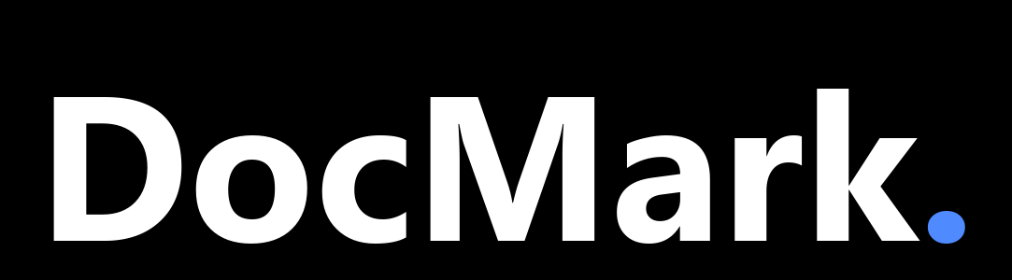
DOCMARK.MD · HOW IT WORKS
Branded. Verified. Delivered.
The six diagrams behind the DocMark enterprise offering — explained.
docmark.md
Notes:
Welcome. This short deck explains the six diagrams you will find on the DocMark website. DocMark turns your content into client-ready, on-brand documents. They are generated by AI where you allow it, rendered by deterministic code always, and visually verified before anything is delivered. Branded. Verified. Delivered. Let's walk through how it works.

Slide 2
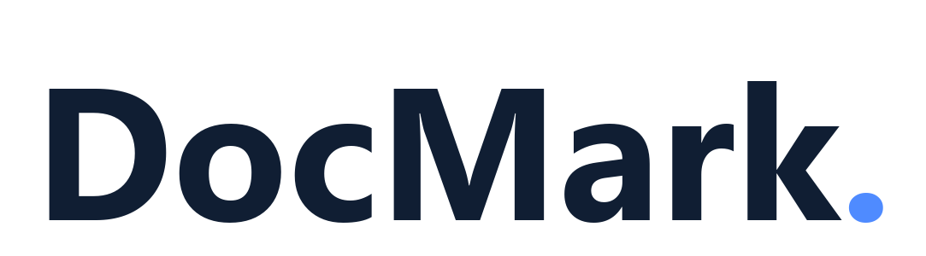
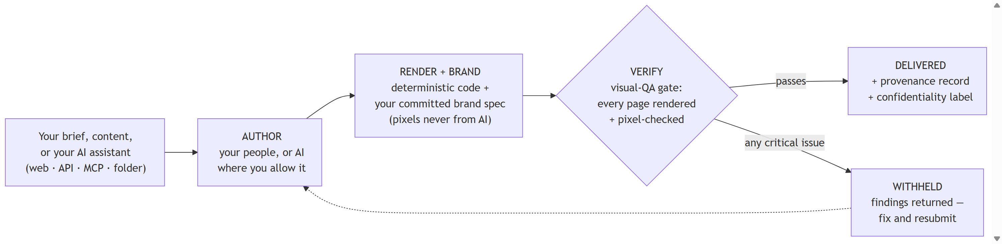
THE PIPELINE
One pipeline, one promise
Author. Your people write the content — or AI does, where you allow it.
Render + brand. Deterministic, tested code applies your committed brand specification. Pixels never come from AI.
Verify. The visual-QA gate renders every page and pixel-checks it. What passes is delivered with a provenance record; what fails is withheld, with findings the author can fix.
© 2026 DocMark. All rights reserved.
docmark.md
Notes:
Every DocMark job follows the same pipeline, whatever door it enters through. First, authoring. Your people write the content, or AI does, where you allow it. Second, rendering. Deterministic, tested code applies your committed brand specification. Pixels never come from AI. Third, verification. The visual QA gate renders every page and checks it, pixel by pixel. What passes is delivered, with a provenance record. What fails is withheld, with precise findings the author can fix and resubmit.

Slide 3
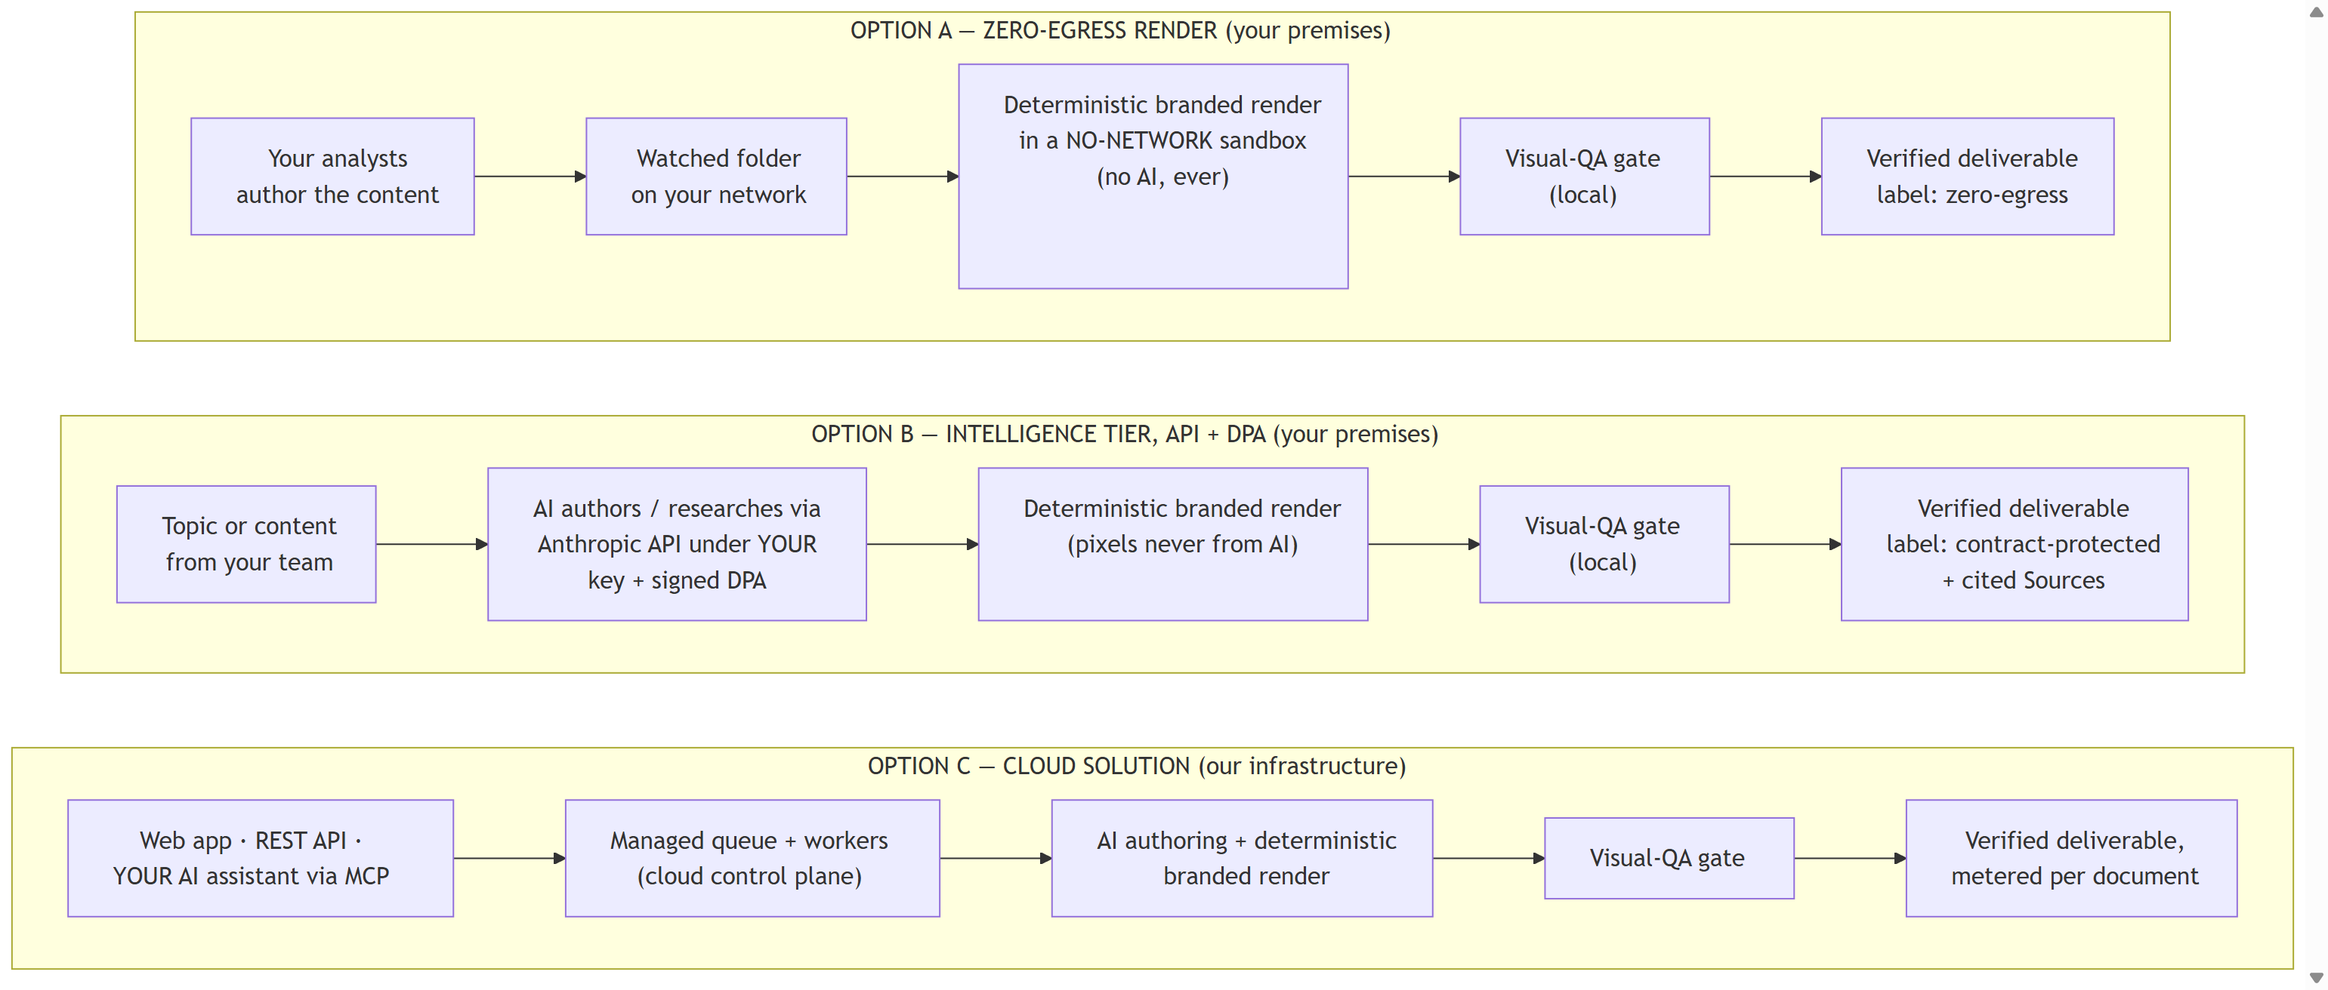
DEPLOYMENT OPTIONS
Three ways to run DocMark
Same pipeline discipline in all three — the difference is where it runs and how much AI you allow.
© 2026 DocMark. All rights reserved.
docmark.md
Notes:
DocMark runs three ways. Option A is the zero egress render, on your premises. Your analysts author the content, a watched folder takes it in, and the render happens in a sandbox with no network, no AI, ever. Option B is the intelligence tier, also on your premises. AI authors and researches through the Anthropic API, under your own key and a signed data processing agreement. Option C is the cloud solution on our infrastructure. Zero install, metered per document. All three end at the same visual QA gate.

Slide 4
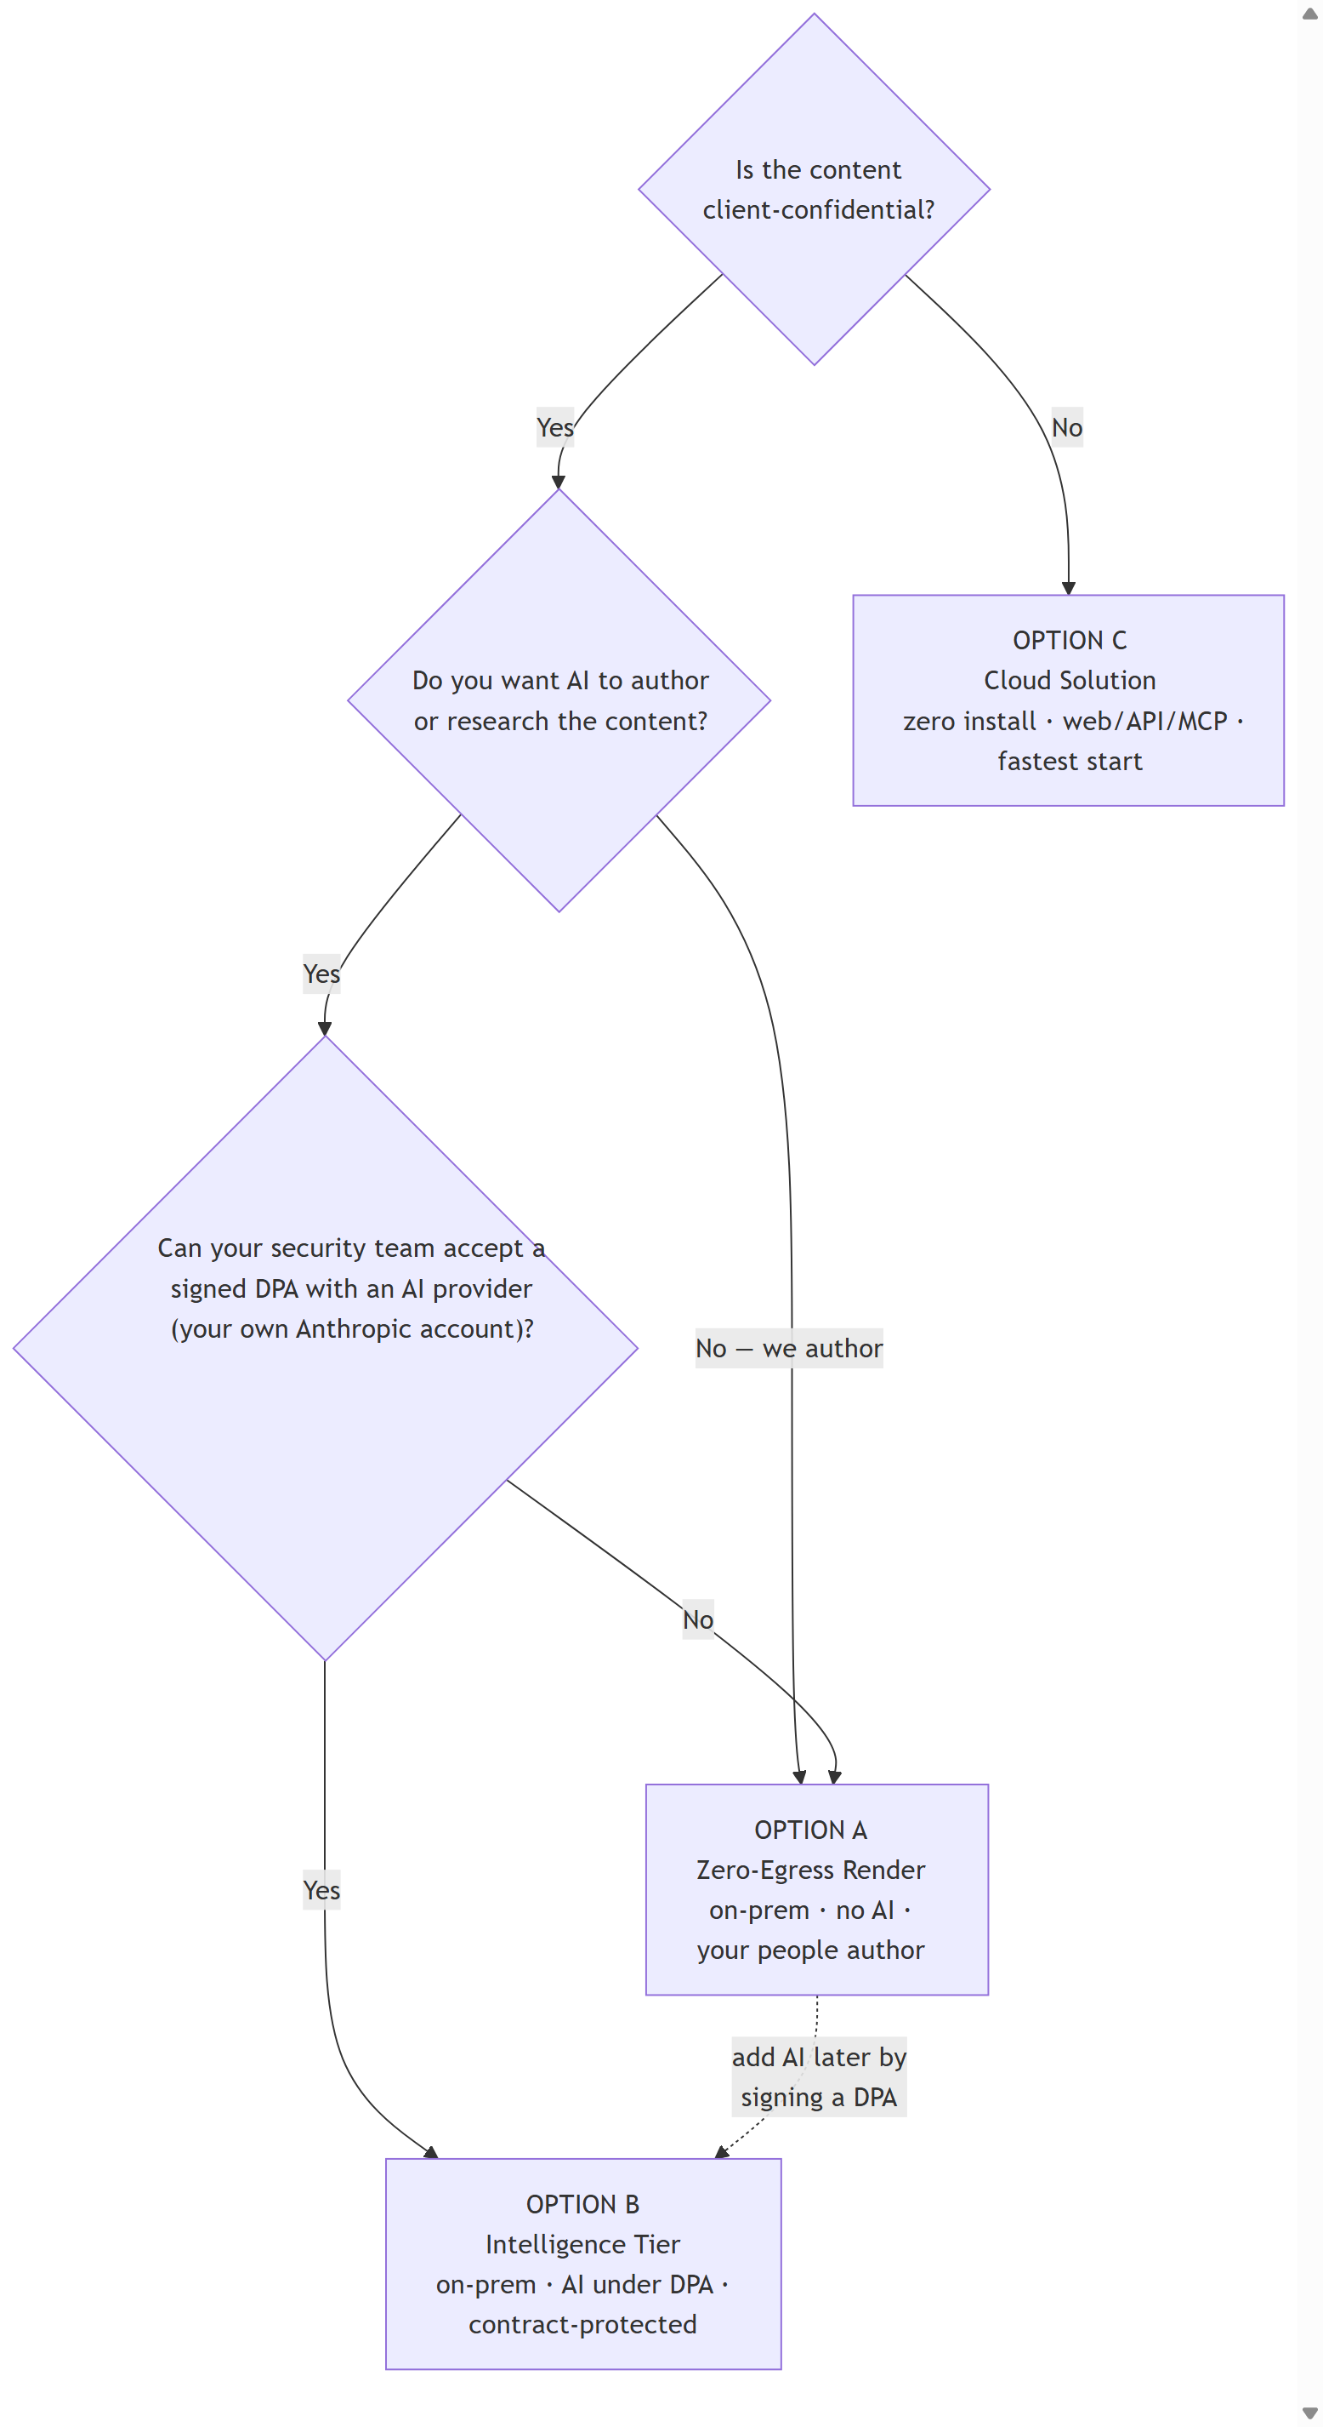
DECISION TREE
Which option fits you?
Is the content client-confidential?
If not, the cloud solution is the fastest start — web app, API, or your AI assistant over MCP.
Do you want AI to author or research?
If your people author everything, the zero-egress render tier keeps the pipeline entirely AI-free — and entirely on your network.
Can your security team accept a signed DPA?
If yes, the intelligence tier gives you AI authoring under your own Anthropic account, contract-protected. If not, start zero-egress — adding AI later is a contractual upgrade, not a technical one.
© 2026 DocMark. All rights reserved.
docmark.md
Notes:
Two questions usually settle the choice. Is the content client confidential? If not, use the cloud. If it is confidential, do you want AI to author or research the content? If your people author everything, choose the zero egress render tier. If you do want AI, the question becomes whether your security team can accept a signed data processing agreement with an AI provider, on your own account. If yes, take the intelligence tier. If not, start zero egress. You can add AI later by signing a DPA. It is the same box, so the upgrade is contractual, not technical.

Slide 5
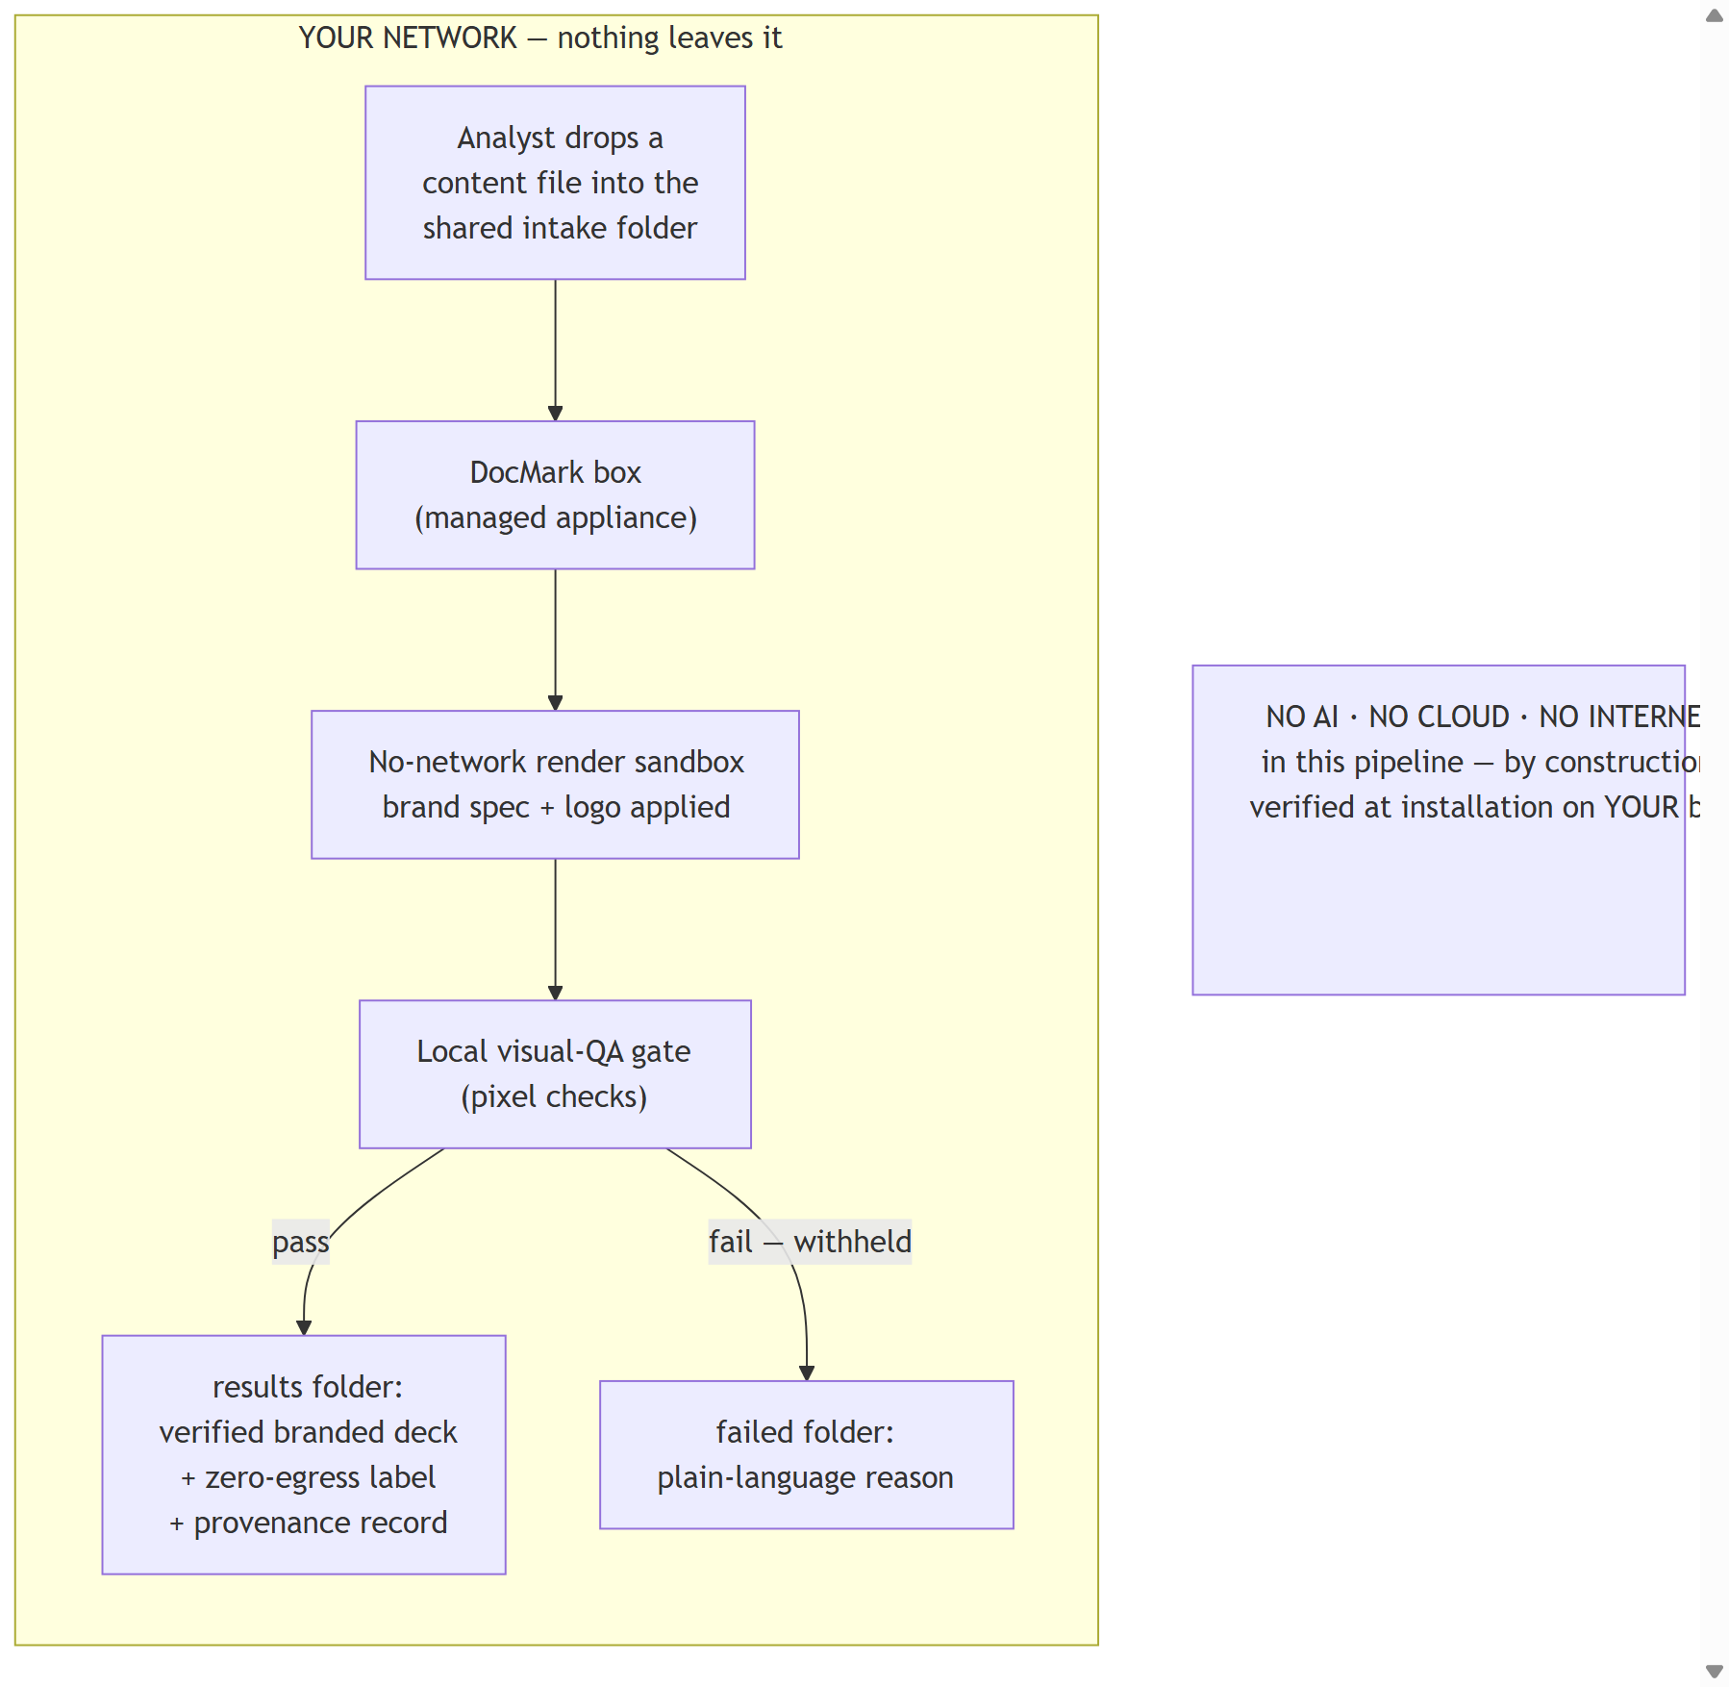
CONFIDENTIAL BY CONSTRUCTION
Option A — Zero-Egress Render
Nothing leaves your network
The DocMark box runs inside your perimeter. Intake is a shared folder; results come back to a results folder.
No AI anywhere in the pipeline
Rendering happens in a no-network sandbox — verified at installation, on your machine, offline.
Machine-written labels
Every deliverable carries a zero-egress label and a provenance record written by the pipeline itself — not by policy documents.
© 2026 DocMark. All rights reserved.
docmark.md
Notes:
Option A in detail. An analyst drops a content file into a shared intake folder. That is the whole integration. The DocMark box picks it up and renders it in a sandbox with no network access, applying your brand specification and logos. The local visual QA gate checks every page. A pass lands in the results folder as a verified branded deliverable, carrying a zero egress label and a provenance record. A fail lands in the failed folder with a plain language reason. No AI, no cloud, no internet anywhere in this pipeline. That is verified at installation, on your box.

Slide 6
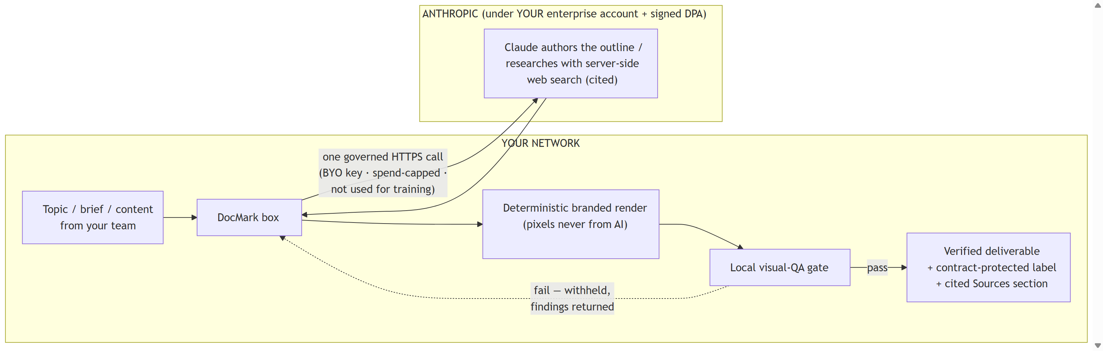
AI UNDER CONTRACT
Option B — Intelligence Tier (API + DPA)
One governed channel. AI calls go to the Anthropic API under YOUR enterprise account (BYO key), spend-capped, governed by a signed DPA — and labelled contract-protected, never “zero-egress.”
Everything else stays local. Deterministic branded rendering and the visual-QA gate run on your box; web research ships with cited sources.
© 2026 DocMark. All rights reserved.
docmark.md
Notes:
Option B adds intelligence. Your team submits a topic, a brief, or existing content. The DocMark box makes one governed call to the Anthropic API, under your own enterprise account, with your own key, spend capped, and governed by a signed data processing agreement. Claude authors the outline or researches the topic, with cited sources. Then everything returns to your box. The deterministic branded render, where pixels never come from AI, and the local visual QA gate. The deliverable is labelled contract protected. We never call this tier zero egress, because it is not. We think that honesty is a feature.

Slide 7
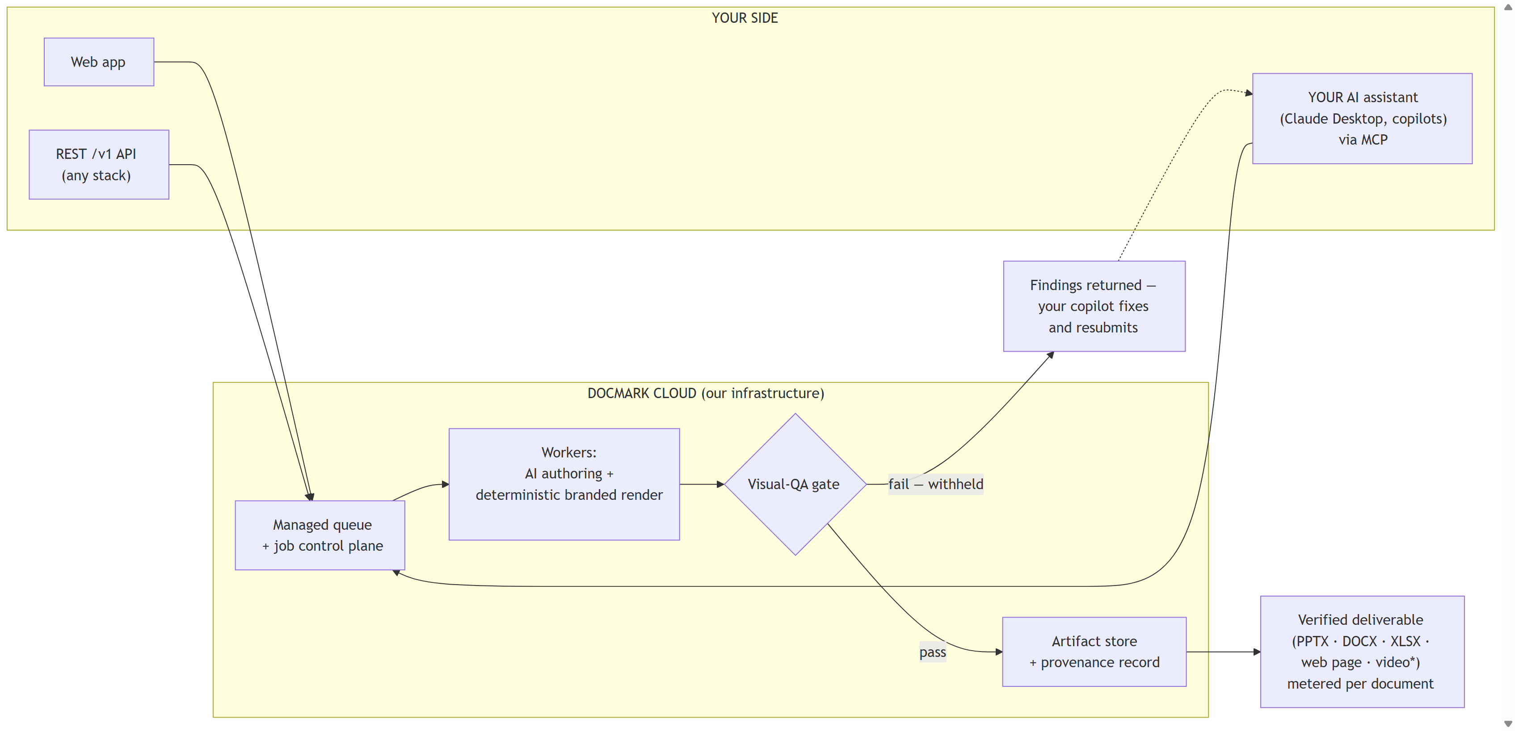
ZERO INSTALL
Option C — Cloud Solution
Three doors in
Web app, REST API, or your AI assistant over MCP.
Managed pipeline
Queue, workers, AI authoring, deterministic render — on our infrastructure.
One gate out
Verified deliverables, metered per document. Failures return findings your copilot can fix and resubmit.
© 2026 DocMark. All rights reserved.
docmark.md
Notes:
Option C is the cloud solution. Nothing to install. Use the web app, call the REST API from any stack, or point your own AI assistant at our MCP server. Jobs flow through a managed queue to workers that author and render. The same visual QA gate stands before delivery, and every deliverable is metered per document with its provenance record. When the gate withholds a deliverable, the findings go back to your copilot, which can fix the content and resubmit.

Slide 8
Branded. Verified. Delivered.
docmark.md · hello@docmark.md
Notes:
That is DocMark. Branded, verified, delivered. See the full comparison and book a pilot at docmark dot M D. Thank you.

